Slide 1
Project Report Social Media Analysis in Insurance
PGP – BABD
Presented By: Suri Parthasarathy

Slide 2
Agenda
Problem/ Challenges
Key Insurance Process and Analytics
Types of Big Data in Insurance
Use Case – Social Media Analysis
Benefits

Slide 3




More Expenses, Less Claims
Global Competition
Challenges
Customer Retention
Fraud Claims

Slide 4
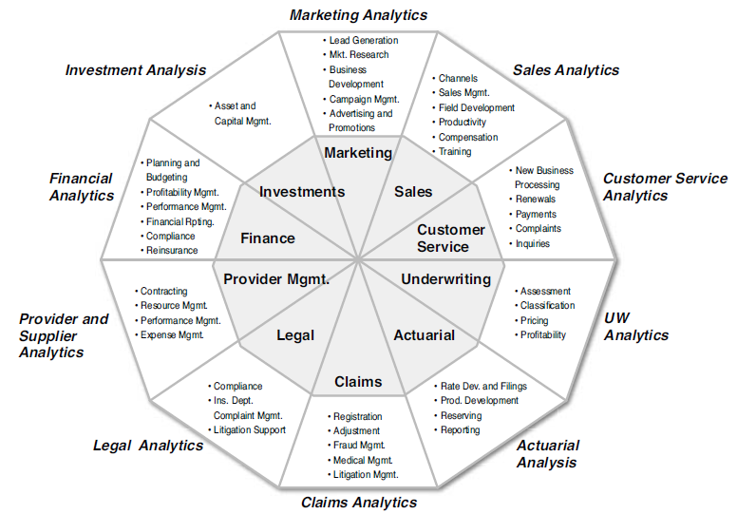
Key Insurance Process and Analytics

Slide 5
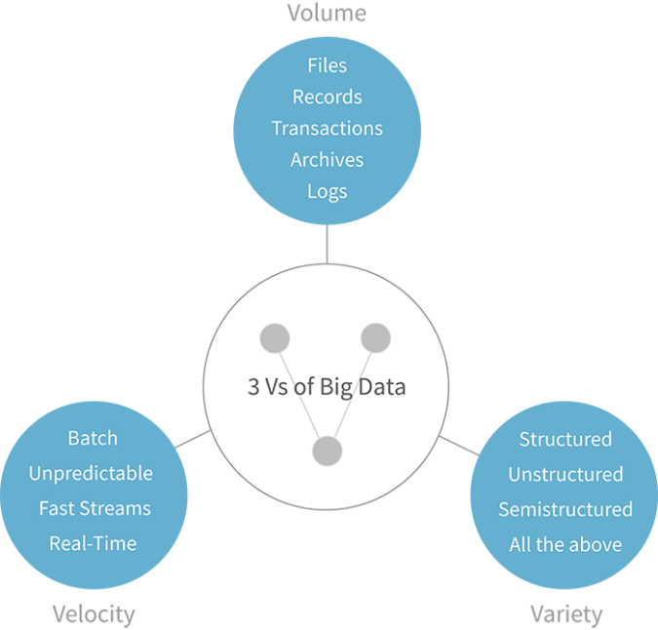
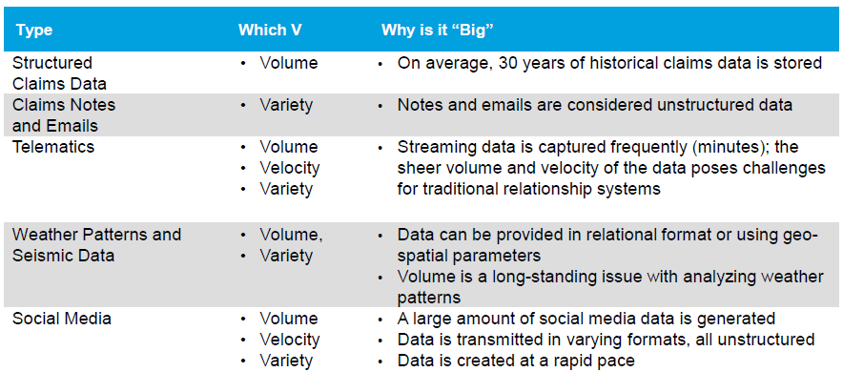
Identifying the types of Big Data in Insurance
Big Data is highly prevalent within insurance, but remains underutilized

Slide 6
Use Case : Social Media Analysis in Insurance Industry
Social Media Analysis
+ve/-ve sentiments about the brand
Loyal Customers
Customer Complaints
Competitor Analysis
Social Media provides insights on Customer behaviour, likes, dislikes, problems and concerns

Slide 7


Reference Architecture
Hortonworks
Data Platform
Source Data
Visualize
LOAD
Interactive
LOAD
Hive & HCATALOG
Solr
Hive / SQL
Solr
Banana
NiFi
Compute & Storage
.
.
.
BATCH
.
.
.
.
HDFS
PIG
.
.
.
Compute & Storage
AMBARI

Slide 8
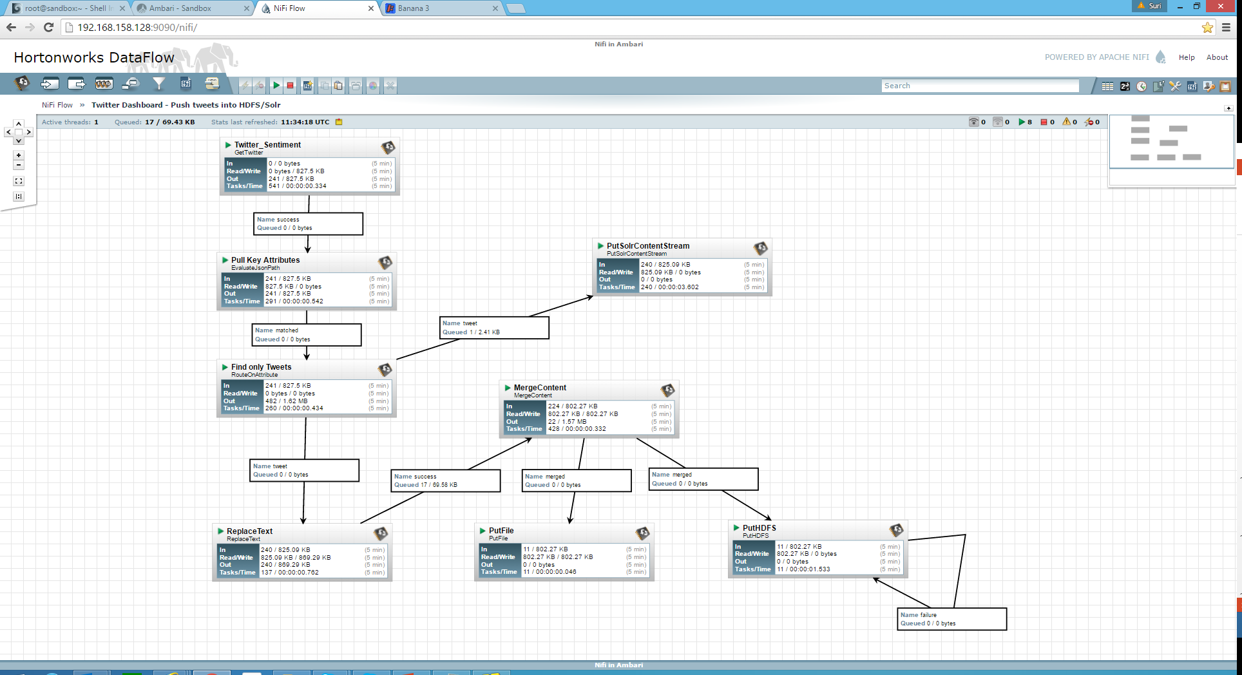
Nifi Setup

Slide 9
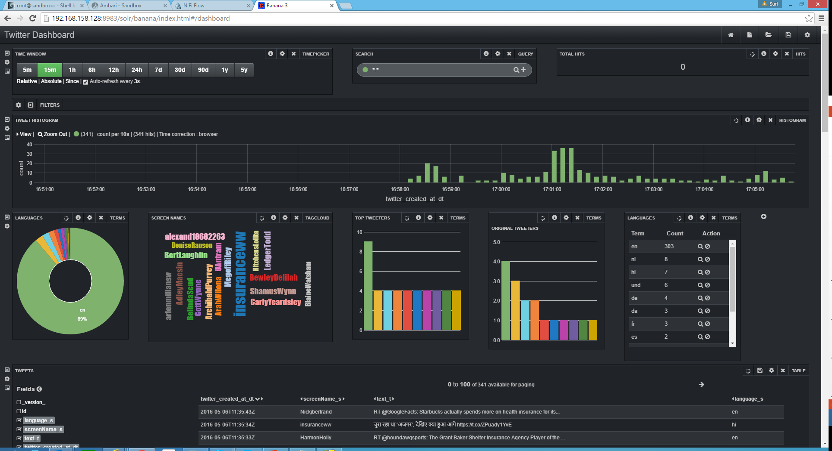
Kibana Visualization

Slide 10
Benefits
Improved brand and enterprises image
Greater reach and visibility
Improved customer relationship

Slide 11
Conclusion
Overall quality of twitter account in the insurance industry is lower compare to other industry
Check for other data sources for better visualization

Slide 12


